Slide 1
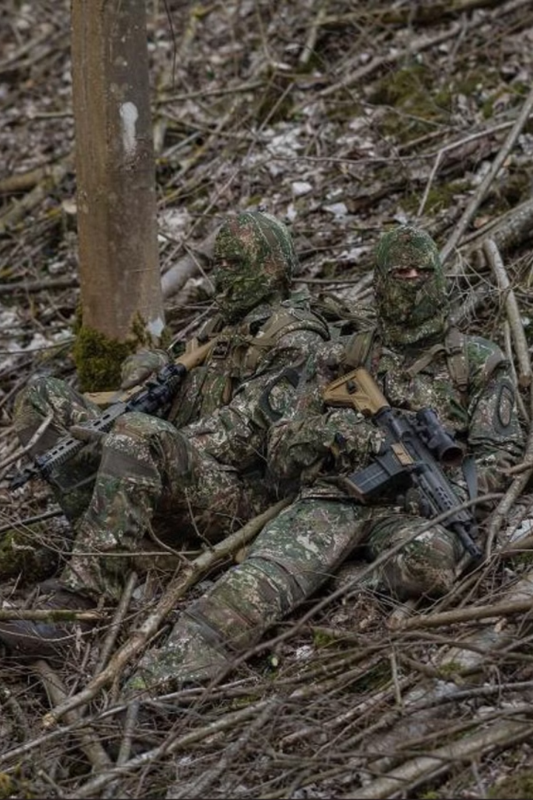
Military Camouflage Detection
This project aims to develop a deep learning based model to detect and classify camouflage effectively in real time, improving situational awareness and operational safety.Developing a deep learning model to detect camouflaged military soldiers in real-time. Blending CNN efficiency with hybrid models to tackle visibility challenges. Empowering surveillance and defense with real-time, terrain-adaptive solutions.
Notes:
1

Slide 2
What is Camouflage?
Concealment: Camouflage is a technique used to blend in with the surrounding environment, making objects or individuals harder to detect.
Disruption: Camouflage patterns break up the outline and shape of the object, disrupting its visual recognition.
Adaptation: Effective camouflage is tailored to the specific terrain and lighting conditions, allowing seamless integration with the environment.
Deception: Camouflage aims to mislead the observer, making it difficult to accurately identify and track the camouflaged target.
Notes:
2

Slide 3
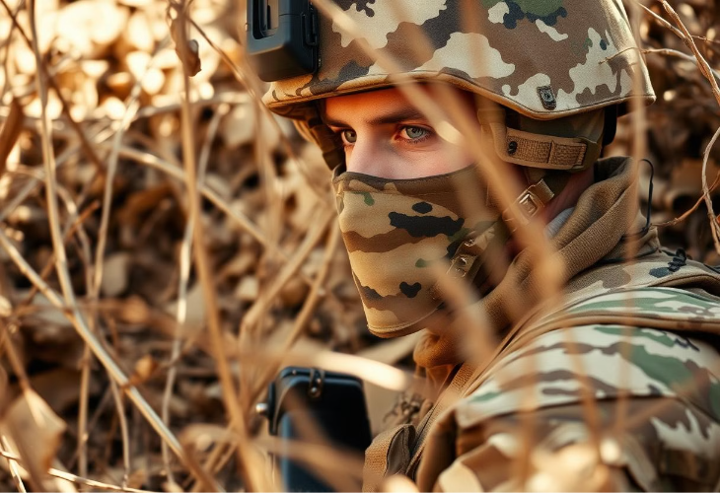
Problem Statement
Objective
The primary objective of this project is to develop a deep learning-based model capable of accurately detecting and classifying camouflaged military soldiers in complex environments. The model aims to:
Enhance situational awareness and operational safety for military applications by identifying hidden or partially visible objects like tanks, jets, and personnel.
Utilize cutting-edge techniques, including CNN and hybrid architectures, to achieve high precision and speed.
Contribute to advancements in automated surveillance and defense systems while minimizing human effort and error.
Notes:
3

Slide 4
Literature Survey
Author
Paper
Year
Yong Wang, Xin Yang
A Camouflaged Object Detection Model Based on Deep Learning
2020
Thi Thu Hang Truong, Trung Kien Tran
Generating Synthetic Data in Military Camouflaged Object Detection
2023
Deng-Ping Fan
Camouflaged Object Detection for Machine Vision Applications
2020
Notes:
4

Slide 5
Research
"A Camouflaged Object Detection Model Based on Deep Learning":
1
The primary technique involves CNNs with advanced modules like attention mechanisms to enhance the detection of hard-to-distinguish objects.
The model integrates multi-scale feature extraction and context-awareness to address the complexities of camouflaged object detection.
Evaluation against standard datasets (e.g., CAMO, COD10K) highlights the effectiveness of CNN-based architectures for this task
"Generating Synthetic Data in Military Camouflaged Object Detection":
2
This paper emphasizes synthetic data generation for training CNN-based models.
Techniques include using data augmentation and synthetic dataset creation to simulate real-world camouflage scenarios.
These approaches aim to improve the robustness of CNN models in identifying camouflaged objects under various environmental conditions
"Camouflaged Object Detection for Machine Vision Applications"
3
Emphasizes the challenge of detecting objects that blend seamlessly into their surroundings, a task essential for military and civilian needs.
It proposes innovative techniques for extracting spatial and feature relationships, enhancing detection accuracy. The study introduces a cascade perception network (CPNet) and ternary cascade perception modules to address high miss rates and low confidence issues.
The proposed methods outperform conventional approaches on datasets like COD10K, achieving significant accuracy improvements and real-world applicability
Notes:
5

Slide 6
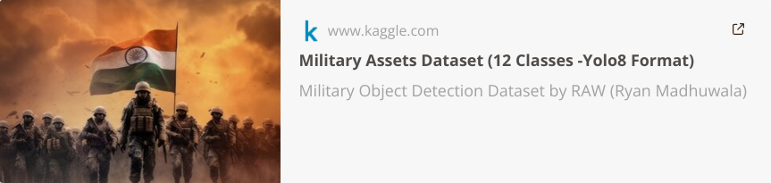

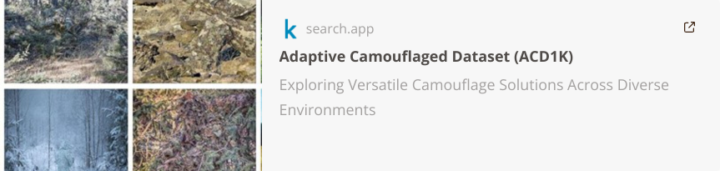

The Military Assets Dataset is a YOLOv8-formatted dataset with 12 classes of military objects such as tanks, jets, and helicopters, designed for real-time object detection tasks.
We use three main types of layers to build ConvNet architectures: Convolutional Layer, Pooling Layer, and Fully-Connected Layer
Adaptive camouflage datasets are specialized collections of annotated images designed to train AI models for detecting camouflaged objects that blend dynamically with varying backgrounds.
Notes:
6

Slide 7
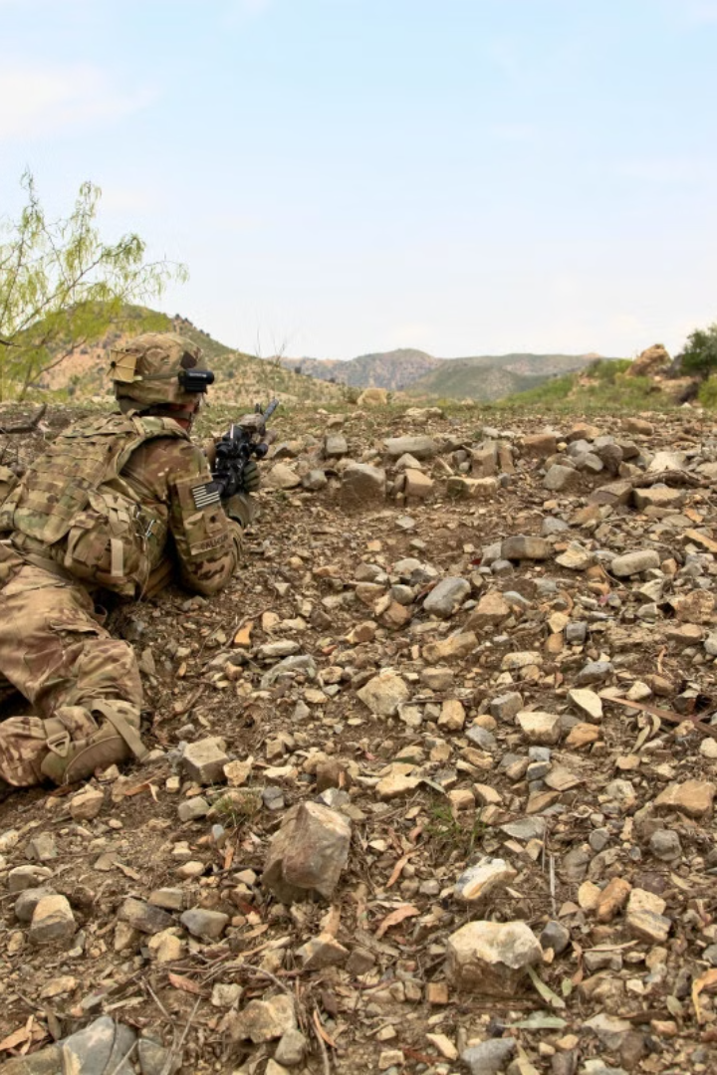

Techniques
Convolutional Neural Networks (CNNs): Used for feature extraction and pattern recognition. Models like ResNet and DenseNet excel at detecting subtle textures and shapes within complex environments.
Hybrid Models: Combining CNNs with Vision Transformers (ViTs) enhances detection by leveraging both feature extraction and global context understanding.
Deep Convolutional Neural Networks: Highly effective for military camouflage detection due to their ability to learn complex patterns and textures in camouflaged environments.
YOLO (You Only Look Once): A real-time object detection framework ideal for identifying camouflaged objects efficiently in dynamic scenarios.
Notes:
7

Slide 8
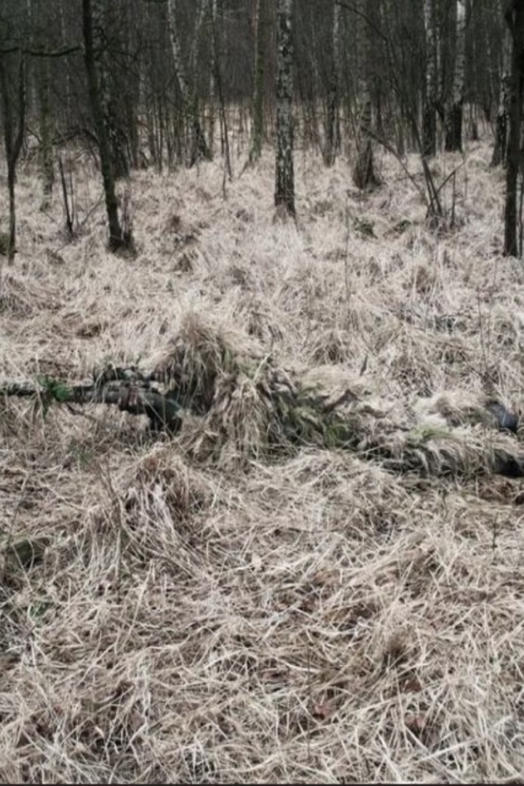

Work Planning
Week 1-4 : Data Collection and Preprocessing
1
Collect and curate camouflage datasets, including real and synthetic images.
Perform data augmentation to simulate diverse terrains and lighting conditions.
Week 5-8 : Model Development and Training
2
Select and implement deep learning architectures (e.g., YOLOv8, Hybrid CNN,Deep CNN).
Train models using optimized settings (e.g., Adam optimizer, swish, relu activation).
Week 9-12 : Testing and Validation
3
Evaluate models on test datasets for accuracy, precision, and recall.
Fine-tune hyperparameters to improve performance in low-contrast scenarios.
Notes:
8

Slide 9
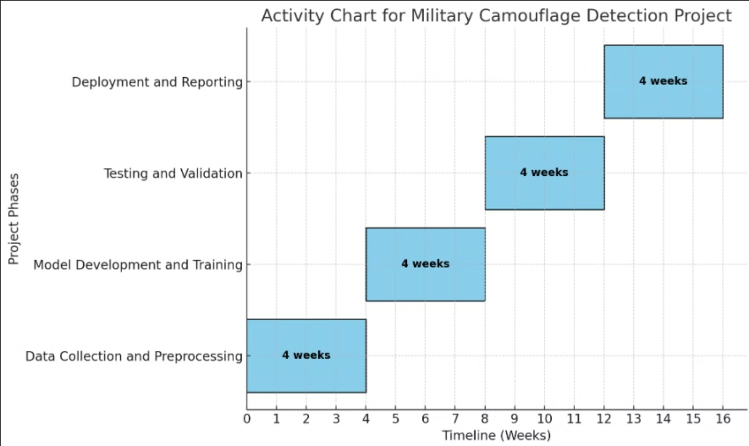
Preparation of bar(activity)chart
Notes:
9

Slide 10
Conclusion
Advancements in Camouflage Detection
Importance of Interdisciplinary Collaboration
Future Considerations
Ongoing research and development are needed to further improve the accuracy, reliability, and real-world applicability of the camouflage detection system.
The project demonstrates the potential of deep learning and sensor fusion techniques to overcome the challenges of military camouflage object detection.
The successful development of this system requires the integration of expertise from computer vision, sensor technology, and military domain knowledge.
Notes:
10

